Slide 1

PERFORMANCE ENHANCEMENT OF IEEE802.11ah BASED IOT NETWORKS USING COOPERATIVE NOMA
BATCH MEMBERS
PROJECT GUIDE
K. Ragupathi
Assistant Professor, Department of ECE,
Velammal Institute of Technology
Date : 10th MAY 2024
NIVETHA N | (113320106029)
MEERA JASMIN J | (113320106025)
SANGAVI S | (113320106035)
SOWMIYA J | (113320106042)

Slide 2
PRESENTATION OUTLINE
Introduction
Literature Survey
Existing method
Objective
Block diagram
Algorithm/Design Equations
Project Model ( Simulation/Hardware model)
Simulation/Hardware Results
Budget
Conclusion
Conference Publication
Scopus Journal status
References

Slide 3
INTRODUCTION
Today, wireless devices are evolving into multipurpose systems with data extensive applications running on them. Such applications require high speed connectivity and strong error protection.
Those needs, along with the exploding growth of wireless networks and limited spectrum resources, have created a capacity crunch and high interference in today’s wireless networks.
This situation entails a move toward the development of new wireless techniques that can achieve a more efficient use of the available spectrum.

Slide 4
INTRODUCTION (cont’d)
The available spectrum is limited, and crowded with users, which leads to more contention that affects the network performance.
The major concerns in wireless networks are : Throughput, Reliability and Energy Efficiency etc.
Non-Orthogonal Multiple Access (NOMA) & Cooperative MAC are proven technologies for the enhancing the performance of wireless communication networks .

Slide 5
INTRODUCTION (cont’d)
IEEE 802.11 ah :
Wireless networking protocol IEEE 802.11ah – or Wi-Fi HaLow – is an amendment to the IEEE 802.11 Wi-Fi standard, published in 2017. Wi-Fi HaLow networks use the Sub-GHz frequency band that allows them to increase the coverage range up to 1 km. IEEE 802.11ah networks support up to 8191 simultaneously connected devices.
NOMA :
Non-orthogonal multiple access (NOMA) is a technique that allows a transmitter to service numerous receivers using the same time-frequency resources. The transmitter can use superposition coding (SC) to broadcast multiple signals at a time. Receivers use successive interference cancellation (SIC) – a mechanism to isolate its one signal from the superposed one.
COOPERATIVE MAC :
Cooperative Medium Access Control (CoopMAC) protocol that is backward compatible with the legacy 802.11 system, in which high data rate stations assist low data rate stations in their transmission by forwarding their traffic.

Slide 6
LITERATURE SURVEY 1
Randy Verdecia-Peña and José I. Alonso, “Performance Analysis of Two-Hop mmWave Relay Nodes over the 5G NR Uplink Signal”, Appl. Sci. 2021, 11, 5828
Proposed Method:
The proposed method in the paper utilizes a two-hop uplink 5G new radio cooperative system with mmWave MIMO, leveraging Relay Nodes (RNs) that use Amplify-and-Forward (A&F) and Decode-and-Forward (D&F) protocols. It incorporates advanced channel knowledge and employs Least Square (LS) channel estimation techniques to improve link reliability and throughput in an indoor-to-outdoor scenario using off-the-shelf mmWave transceiver components.
Advantages:
The advantage is a substantial improvement in Bit error rate(BER) and throughput,demonstrating enhanced performance in NR-UE(New radio-User equipment) to gNodeB(Next generation Node B),communications particularly with high modulation schemes like QAM(quadrature amplititude Modulation).
Limitations:
The limitation may include the reliance on ideal channel conditions and potential hardware constraints in practical implementations.

Slide 7
LITERATURE SURVEY 2
B. S. Pavan and V. Harigovindan, “A novel channel access scheme for NOMA based IEEE 802.11 WLAN,” Sadhan ¯ a¯, vol. 46, no. 3, pp. 1–6, 2021.
Proposed Method:
In this paper, the authors proposed a novel channel access mechanism based on NOMA for next-generation IEEE 802.11 WLANs. The access point groups stations for UL NOMA transmission depending on the applied modulation and coding scheme (MCS). Each group has a main station that is closer to the access point than the others. In the proposed scheme, only the main stations compete for the channel while the remaining stations transmit data only in UL NOMA.
Advantages:
The proposed scheme allows simultaneous transmissions by user-cluster nodes in the same resource block using NOMA as well as reduce the number of contending nodes
Limitations:
The node nearest to the access point transmits data with the highest data rate, while
the farthest node transmits data with the lowest.

Slide 8
LITERATURE SURVEY 3
Md. Forkan Uddin 2019 Throughput performance of NOMA in WLANs with a CSMA MAC protocol. Wirel. Netw. 25: 3365–3384
Proposed Method:
In this paper, the author proposed a carrier sense multiple access (CSMA) MAC protocol to increase downlink throughput by utilizing the opportunities offered by NOMA technique in downlink access of WLANs. For downlink transmission, an algorithm is developed to select an optimal user-set with appropriate power allocation from a randomly selected user-set.
Advantages:
The downlink through put under the proposed MAC protocol increases significantly with increasing the transmitting power at the AP
WLAN under the proposed MAC protocol supports a higher number of users by maintaining the same downlink throughput to the users.
Limitations:
The proposed scheme was implemented on a conventional WLAN with two user
clustering.

Slide 9
OVERALL INFERENCE FROM LITERATURE SURVEY
 | Literature Survey 1 | Literature Survey 2 | Literature Survey 3
Advantage | Significantly improves BER and throughput in NR-UE to gNodeB(Nextgeneration Node B), communications. | The proposed scheme allows simultaneous transmissions by user-cluster nodes in the same resource block using NOMA as well as reduce the number of contending nodes | Proposed MAC protocol boosts downlink throughput with higher AP power, supporting more users without reducing individual user throughput.
Limitation | The limitation may include the reliance on ideal channel conditions and potential hardware constraints in practical implementations | The node nearest to the access point transmits data with the highest data rate, while the farthest node transmits data with the lowest. | The proposed scheme was implemented on a conventional WLAN with two user clustering.
Method adopted | The method enhances 5G uplink using two-hop mmWave MIMO and Relay Nodes with A&F and D&F protocols, advanced channel knowledge, and LS estimation, boosting reliability and throughput. | Novel channel access mechanism using NOMA proposed for next-gen IEEE 802.11 WLANs, grouping stations by proximity and MCS. | The paper proposes CSMA MAC protocol using NOMA to optimize downlink WLAN throughput via user-set selection and power allocation algorithm.

Slide 10
EXISTING METHOD
Different from conventional point to point and point to multipoint communications, cooperative communication allows multiple users or stations in a wireless network to coordinate their packet transmissions and share each other’s resources, thus achieving cooperative diversity or user cooperative diversity
At present a MAC protocol to provide Cooperative communication in distributed manner. In order to select the relay node among its neighbors, the proposed protocol employs a relay selection with relay collision avoidance and three way handshaking mechanism. The MAC performance metrics such as throughput, energy efficiency, and service delay are not considered in the analysis.

Slide 11
EXISTING METHOD
As NOMA facilitates multiple transmissions simultaneously, its inclusion in the 802.11ah brings forth the opportunity to utilize the spectrum efficiently, reduce the channel contention, and improve the scalability of IoT networks.
A few works have been published to examine NOMA for WLANs.
The authors in used NOMA and proposed a smart antennae based beam allocation system to improve the average user throughput by serving two users simultaneously.
Targeting the multi-channel ALOHA based WLANs, the authors in proposed a NOMA aware MAC protocol to improve the uplink throughput and scalability by exploiting different transmission power levels based on the channel gains.

Slide 12
OBJECTIVE
Understanding Cooperative NOMA Protocol for Wireless Local Area Networks.
To implement Cooperative NOMA Protocol for enhancing the performance of IEEE802.11ah IoT Networks to attain Throughput, Energy Efficiency ,Scalability , Delay.
To compare the performance of COOPERATIVE NOMA protocol with IEEE 802.11ah IoT Networks.
Develop a scheme to implement Cooperative technique to previously implemented channel access mechanism for NOMA based IEEE 802.11ah and analyse its saturation throughput.

Slide 13
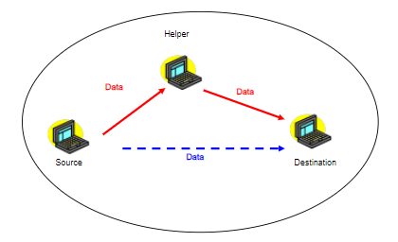
COOPMAC PROTOCOL
In the legacy 802.11 system, source station
transmits to the receiver directly and
Transmissions from the other stations will be
discarded.
However, we can achieve better performance if
user cooperation is allowed.
Protocol features:
Backward compatible.(Both uplink and downlink)
Improve the throughput and delay performance of the legacy 802.11 network.
Fig.1: Cooperative Transmission

Slide 14
In the legacy 802.11 system, source station transmits to the receiver directly and transmissions from the other stations will be discarded. However, we can achieve better performance if user cooperation is allowed.
The basic idea is to allow nodes to choose a transmission scheme (direct or relayed) and a data rate based upon real-time link measurements.
Once a source node S has a data packet to transmit, it sends an RTS (Request-To-Send) frame to the destination node D. When D receives the RTS frame it chooses the transmission scheme (direct, relayed) based on the SNR (Signal to Interference and Noise Ratio) value measured from the RTS frame signal.
D compares this SNR value with a predefined SNR threshold, denoted by SNRcoop.
when the SNR value is greater than SNRcoop, a direct transmission is implemented, if not rely transmission is implemented.

Slide 15
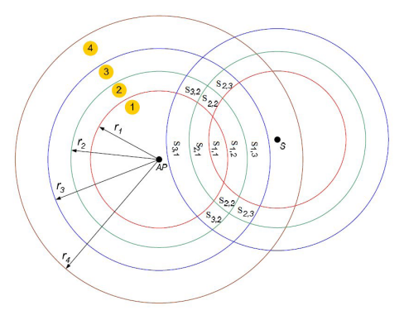
RELAY DISTRIBUTION
Consider a one cell (BSS) wireless local area network (WLAN) consisting of an access point (AP) and N nodes. The nodes are uniformly distributed in the coverage area. The network supports different data rates, denoted by R_{m}, where R₁ > R₂ > R₃ > ... . and the maximum transmission radius of a node at data rate R_{m} is r_{m}, where r₁ < r₂ < r₃ < ...
We define S_{x,y} as the region in which the helper node can be available, where the data rate of the first hop (source to helper) is x Mbps and of the second hop (helper to AP) is y Mbps.
Fig.2: Relay distribution

Slide 16
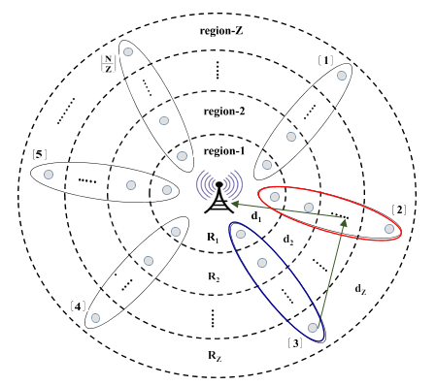
COOPERATIVE NOMA BASED WLAN
Here, In the transmitting cluster the lower transmission node (at data rate 1Mbps) will transmit to the base station by using cooperative transmission with the help of adjacent clusters.
- Helper cluster
- Transmitting cluster
Fig.3: Cooperative NOMA based WLAN

Slide 17
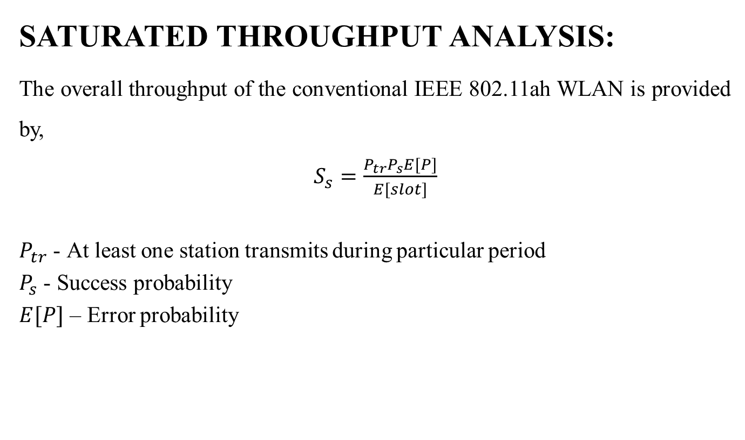
ALGORITHM/DESIGN EQUATION
SATURATED THROUGHPUT ANALYSIS:
The overall throughput of the conventional IEEE 802.11ah WLAN is provided by,
$S_{s}=\frac{P_{tr}P_{s}E[P]}{E[slot]}$
$P_{tr}$ - At least one station transmits during particular period
$P_{s}$ - Success probability
$E[P]$ – Error probability

Slide 18
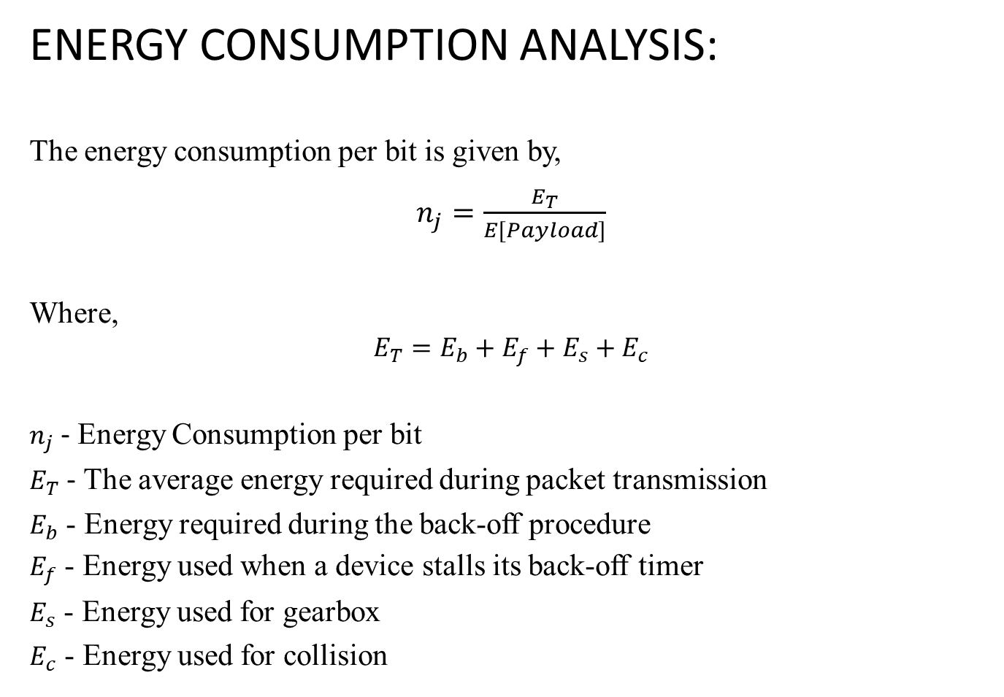
ENERGY CONSUMPTION ANALYSIS:
The energy consumption per bit is given by,
$n_{j}=\frac{E_{T}}{E[Payload]}$
Where,
$$E_{T}=E_{b}+E_{f}+E_{s}+E_{c}$$
$n_{j}$ - Energy Consumption per bit
$E_{T}$ - The average energy required during packet transmission
$E_{b}$ - Energy required during the back-off procedure
$E_{f}$ - Energy used when a device stalls its back-off timer
$E_{s}$ - Energy used for gearbox
$E_{c}$ - Energy used for collision

Slide 19

DELAY ANALYSIS:
The delay equation is given by,
Delay =$\frac{T_{received packet at destination}−T_{packet sent from source}}{Packet Received}$

Slide 20
PROJECT MODEL ( SIMULATION/HARDWARE)
To create analytical model using MATLAB Software.

Slide 21
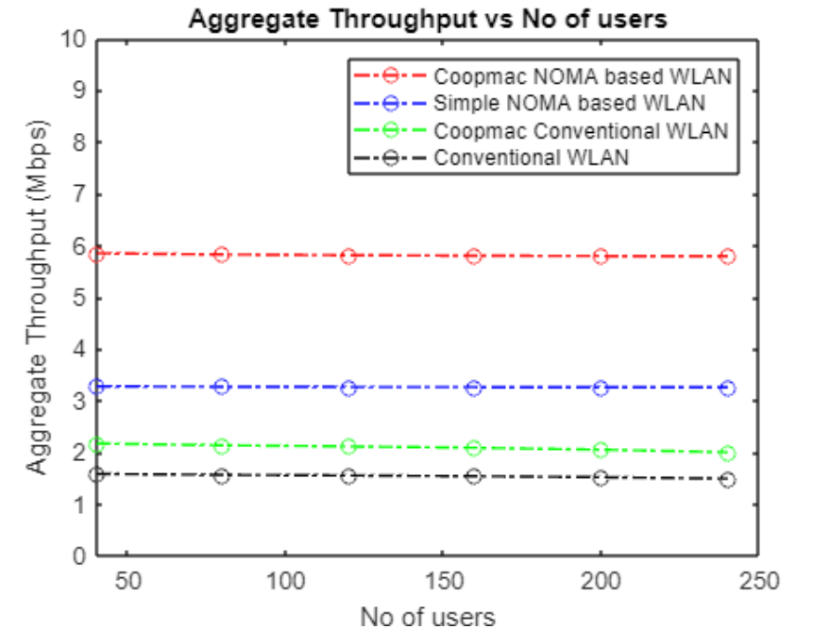
SIMULATION RESULT
THROUGHPUT ANALYSIS:
Simulation parameter for throughput analysis
Packet Payload | 8184 bits
MAC Header | 272 bits
PHY Header | 128 bits
ACK | 240 bits
RTS | 288 bits
CTS | 240 bits
Channel Bit Rate | 1 Mbit/s
Propagation Delay | 1 µs
Slot Time | 50 µs
SIFS | 28 µs
DIFS | 128 µs
ACK_Timeout | 300 µs
CTS_Timeout | 300 µs

Slide 22
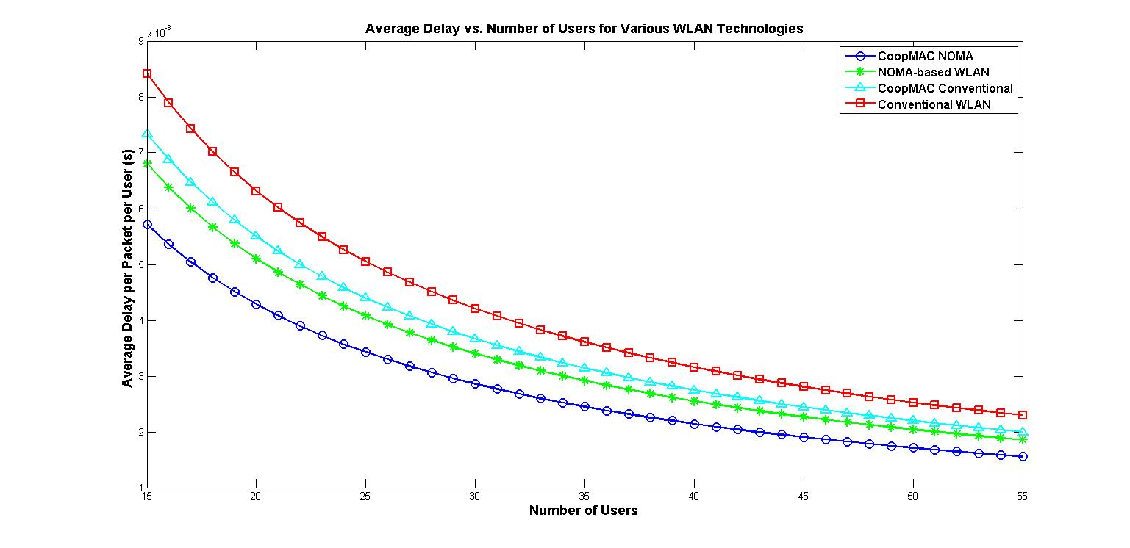
DELAY ANALYSIS:

Slide 23
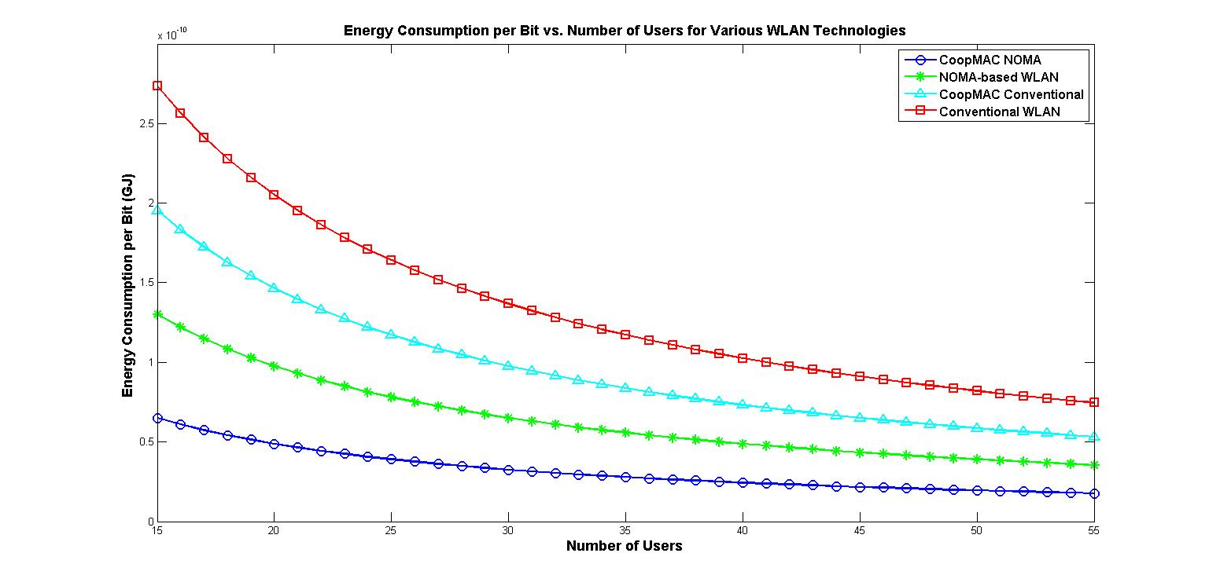
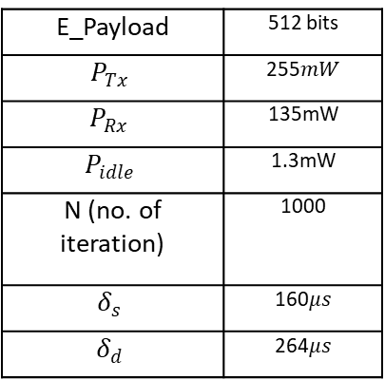
ENERGY CONSUMPTION ANALYSIS:
Simulation parameters for energy consumption analysis
E_Payload | 512 bits
 | 135mW
 | 1.3mW
N (no. of iteration) | 1000

Slide 24
CONCLUSION
Cooperative NOMA enhances IoT networks by improving spectral efficiency, extending coverage, and reducing latency, allowing more simultaneous transmissions, especially in dense environments. However, managing interference and device coordination complexities is crucial for its successful implementation and maximizing its benefits.

Slide 25
CONFERENCE PUBLICATION
Presented our paper titled “Performance Enhancement of IEEE802.11ah Based IoT Network using Cooperative NOMA ” in the 4th International Conference on Artificial Intelligence, 5G Communications and Network Technologies (ICA5NT 2024) held at Velammal Institute of Technology on 21st & 22nd March 2024.

Slide 26
SCOPUS JOURNAL STATUS
Applied for Scopus indexed book chapter titled “Contemporary Challenges on Artificial Intelligence, 5G Communications, Industry 5.0, Intelligent Computing, and Network Technologies” by Nova Science Publishers.

Slide 27
References
Aritz, Abuin., Lorenz, Fanari., Eneko, Iradier., Jon, Montalban. (2022) ‘High Efficiency Wireless-NOMA Solutions for Industry 4.0’, IEEE 18th International Conference on Factory Communication Systems (WFCS) PP.1012-1017.
Ahsan, Raza, Khan., and Sarmad, Sohaib. (2021) ‘Cooperative NOMA, Prototyping and Experimental Evaluation Using SDR’, IEEE TRANSACTIONS ON VEHICULAR TECHNOLOGY, (Vol. 70), NO. 3.PP.35-38
BadarlaSri, Pavan., Ragupathi, K. Harigovindan, V. P. (2023) ‘TXOP Tuning‑based Channel Access Scheme for Performance Enhancement of IEEE 802.11ah Multirate NOMA‑IoT Networks’, Natl. Acad. Sci. Lett. 46(2):PP.123–127.
Jiazhen, Zhang., Xiaofeng, Tao., Huici, Wu., And Xuefei,Zhang. (2018) ‘Performance Analysis of User Pairing in Cooperative NOMA Networks’, IEEE Access (Vol. 6) PP.29.
Kyung-Seop, Shin.,and Ohyun, Jo, Member.,(2017) ‘Joint Scheduling and Power Allocation Using Non-orthogonal Multiple Access in Directional Beam-based WLAN Systems’, IEEE WirelessCommunications Letters.

Slide 28
THANK YOU

